Slide 1
CS3081: “Artificial Intelligence”
Prof Passent Elkafrawy
pelkafrawy@effatuniversity.edu.sa
CoE112, ext 7896

Slide 2
Outline
Course overview
What is AI?
A brief history
The state of the art

Slide 3
Intelligent machines, or what machines can do
Philosophers have been trying for over 2000 years to understand and resolve two Big Questions of the Universe::
How does a human mind work,, and
Can non-humans have minds?
These questions are still unanswered.
Intelligence is the ability to understand and learn things.
Intelligence is the ability to think and understand instead of doing things by instinct or automatically.
(Essential English Dictionary,, Collins,, London,, 2008)

Slide 4
Intelligent machines,
In order to think, someone or something has to have a brain, or an organ that enables someone or something to learn and understand things, to solve problems and to make decisions. So we can define intelligence as the ability to learn and understand, to solve problems and to make decisions.
The goal of artificial intelligence (AI) as a science is to make machines do things that would require intelligence if done by humans. Therefore, the answer to the question Can Machines Think? was vitally important to the discipline.
The answer is not a simple “Yes” or “No”.

Slide 5
What is AI?
Views of AI fall into four categories:
The textbook advocates "acting rationally"
Thinking humanly | Thinking rationally
Acting humanly | Acting rationally

Slide 6
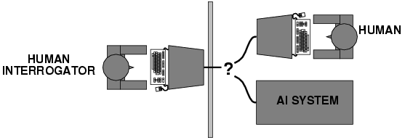
Acting humanly: Turing Test
Turing (1950) "Computing machinery and intelligence":
"Can machines think?" → "Can machines behave intelligently?"
Operational test for intelligent behavior: the Imitation Game
Predicted that by 2000, a machine might have a 30% chance of fooling a lay person for 5 minutes
Anticipated al major arguments against AI in following 50 years
Suggested major components of AI: knowledge, reasoning, language understanding, learning
Notes:
Turing believed that by the end of the 20th century it would be possible to program a digital computer toplaytheimitationgame. Althoughmodern computers still cannot pass the Turing test, it provides a basis for the verification and validation of knowledge-based systems.
I A program thought intelligent in some narrow area of expertise is evaluated by comparing its performance with the performance of a human expert.

Slide 7
Thinking humanly: cognitive modeling
1960s "cognitive revolution": information-processing psychology
Requires scientific theories of internal activities of the brain
How to validate? Requires
1) Predicting and testing behavior of human subjects (top-down) or
2) Direct identification from neurological data (bottom-up)
Both approaches (roughly, Cognitive Science and Cognitive Neuroscience) are now distinct from AI

Slide 8
Thinking rationally: "laws of thought"
Aristotle: what are correct arguments/thought processes?
Several Greek schools developed various forms of logic: notation and rules of derivation for thoughts; may or may not have proceeded to the idea of mechanization
Direct line through mathematics and philosophy to modern AI
Problems:
Not al intelligent behavior is mediated by logical deliberation
What is the purpose of thinking? What thoughts should I have?

Slide 9
Acting rationally: rational agent
Rational behavior: doing the right thing
The right thing: that which is expected to maximize goal achievement, given the available information
Doesn't necessarily involve thinking – e.g., blinking reflex – but thinking should be in the service of rational action

Slide 10
Rational agents
An agent is an entity that perceives and acts
Abstractly, an agent is a function from percept histories to actions:
[f: P* → A]
For any given class of environments and tasks, we seek the agent (or class of agents) with the best performance
Caveat: computational limitations make perfect rationality unachievable
→ design best program for given machine resources

Slide 11
AI prehistory
Philosophy Logic, methods of reasoning, mind as physical system foundations of learning, language, rationality
Mathematics Formal representation and proof algorithms, computation, (un)decidability, (in)tractability, probability
Economics utility, decision theory
Neuroscience physical substrate for mental activity
Psychology phenomena of perception and motor control, experimental techniques
Computer building fast computers engineering
Control theory design systems that maximize an objective function over time
Linguistics knowledge representation, grammar

Slide 12
Abridged history of AI
1943 McCuloch & Pits: Boolean circuit model of brain (ANN)
1950 Turing's "Computing Machinery and Intelligence"
1956 Dartmouth meeting: "Artificial Intelligence" adopted
1952—69 Look, Ma, no hands!
1950s Early AI programs, including Samuel's checkers program, Newel & Simon's Logic Theorist, Gelernter's Geometry Engine
1965 Robinson's complete algorithm for logical reasoning
1966—73 AI discovers computational complexity Neural network research almost disappears
1969—79 Early development of knowledge-based systems
1980-- AI becomes an industry
1986-- Neural networks return to popularity
1987-- AI becomes a science
1995-- The emergence of intelligent agents

Slide 13
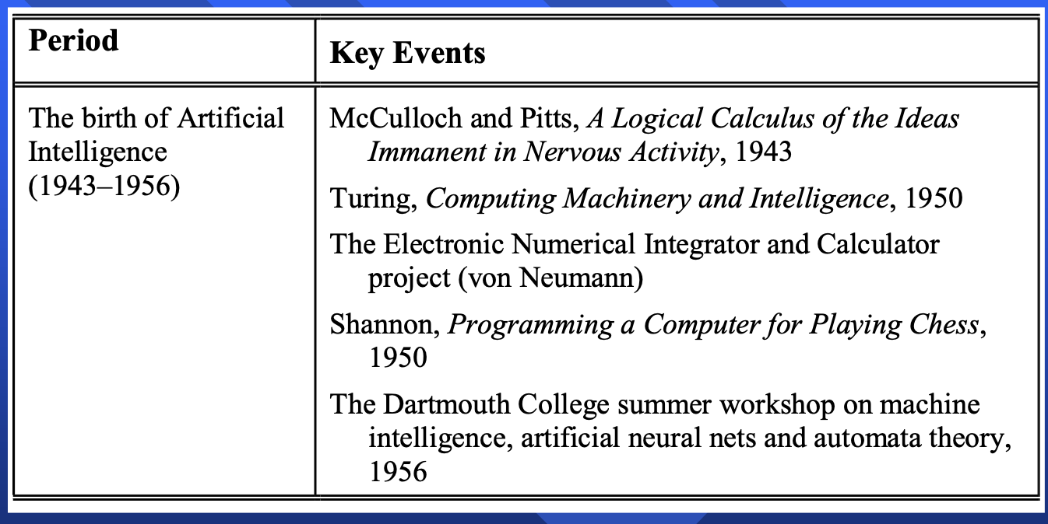
Main events in the history of AI
The first work recognised in the field of AI was presented by Warren McCulloch and Walter Pitts in 1943. They proposed a model of an artificial neural network and demonstrated that simple network structures could learn.
McCulloch, the second “founding father” of AI after Alan Turing, had created the corner stone of neural computing and Artificial Neural Networks (ANN).
The third founder of AI was John von Neumann, the brilliant Hungarian-born mathematician. In 1930, he joined the Princeton University, lecturing in mathematical physics. He was an adviser for the Electronic Numerical Integrator and Calculator project at the University of Pennsylvania and helped to design the Electronic Discrete Variable Calculator.

Slide 14
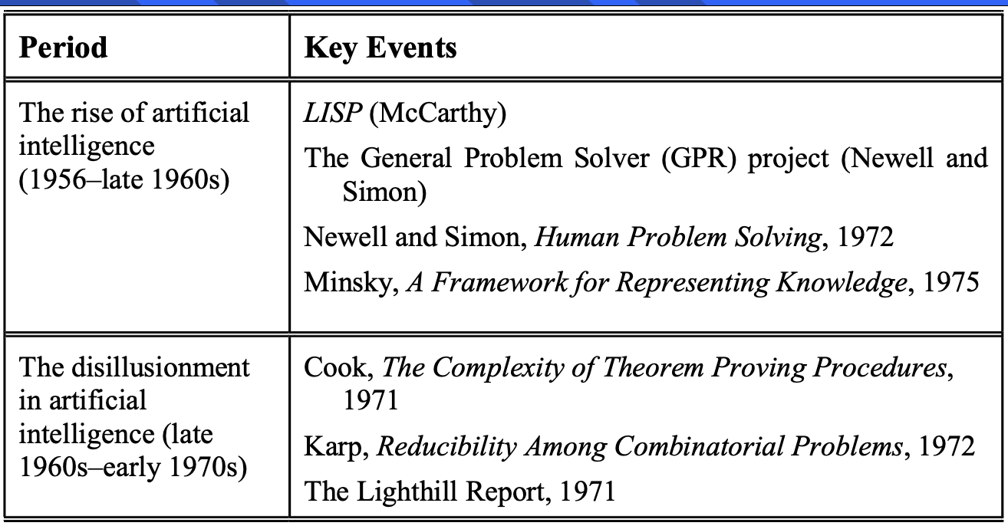
Another of the first generation researchers was Claude Shannon. He graduated from MIT and joined Bell Telephone Laboratories in 1941. Shannon shared Alan Turing’s ideas on the possibility of machine intelligence. In 1950, he published a paper on chess-playing machines, which pointed out that a typical chess game 120 involved about 10¹²⁰ possible moves (Shannon, 1950). Even if the new vonNeumann-type computer could examine one move per 106 microsecond, it would take 3 × 10¹⁰⁶ years to make its first move. Thus Shannon demonstrated the need to use heuristics in the search for the solution.
In 1956, John McCarthy, Martin Minsky and Claude Shannon organised a summer workshop at Dartmouth College. They brought together researchers interested in the study of machine intelligence, artificial neural nets and automata theory. Although there were just ten researchers, this workshop gave birth to a new science called artificial intelligence.

Slide 15
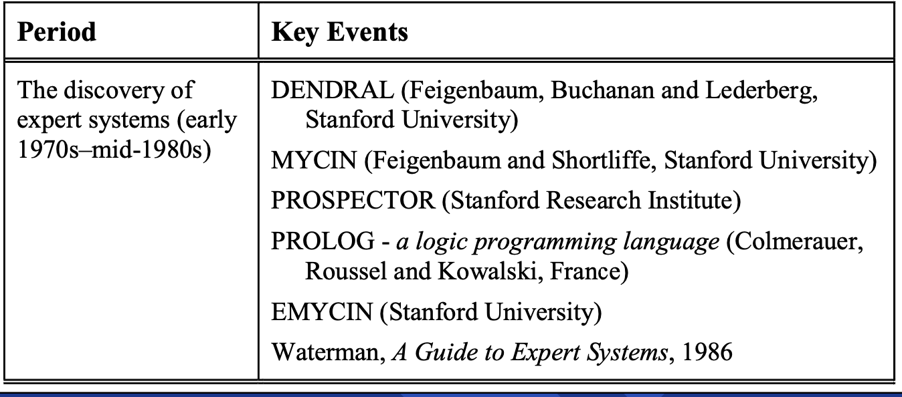

Slide 16
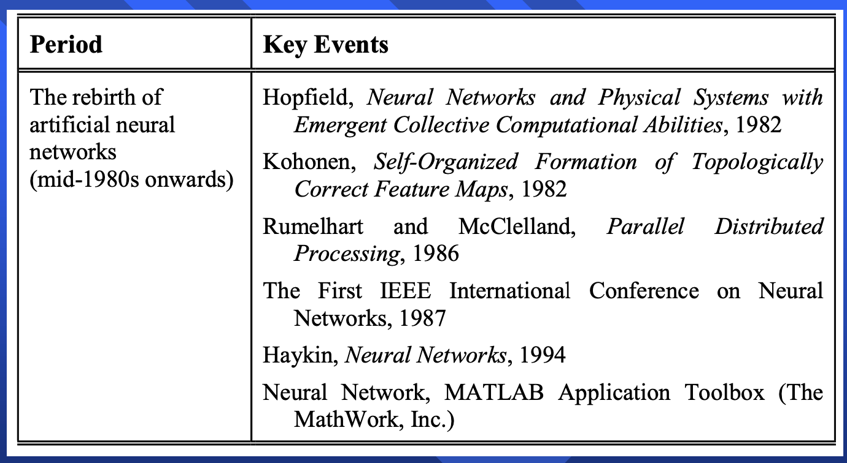

Slide 17
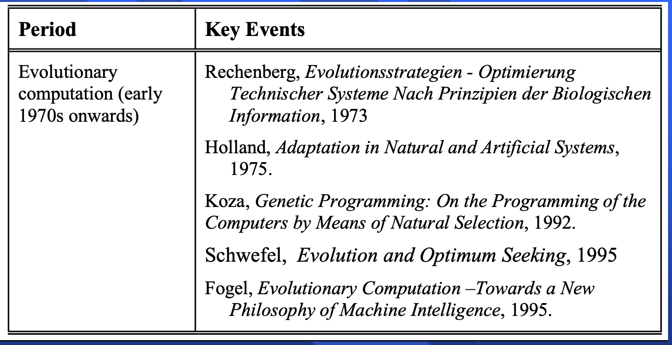

Slide 18
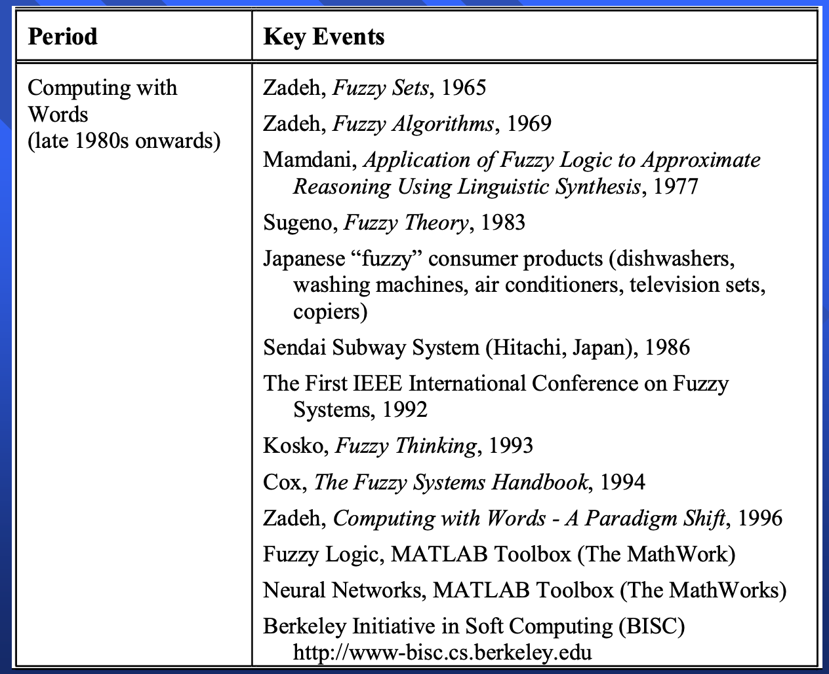

Slide 19
State of the art
Deep Blue defeated the reigning world chess champion Garry Kasparov in 1997
Proved a mathematical conjecture (Robbins conjecture) unsolved for decades
No hands across America (driving autonomously 98% of the time from Pitsburgh to San Diego)
During the 1991 Gulf War, US forces deployed an AI logistics planning and scheduling program that involved up to 50,000 vehicles, cargo, and people
NASA's on-board autonomous planning program controlled the scheduling of operations for a spacecraft
Proverb solves crossword puzzles better than most humans

